Slide 1
The 5 Stages of Downscoping Or: How We Learned to Stop Worrying and Love the Cut
Team CIGAM

Slide 2
Vision
From the HLDD: “The core idea of this game is a system that a player can never fully explore. We want them to feel like there’s always a new idea to come up with.”
A procedurally parsed magic system that a player could learn about
A world that a player could meaningfully interact with

Slide 3
Demo

Slide 4
The 5 Stages of Downscoping
Denial
Anger
Bargaining
Depression
Acceptance

Slide 5
Denial: Refusing to Accept Failures of Scope
Insistence that could do more than we could
Overestimation of availability and underestimation of difficulty

Slide 6
Lessons Learned
Overestimate how long overall tasks will take
While large tasks may take the time expected, unexpected small tasks add up
Don’t hand-wave art/sound/UI/frontend (we’ll find someone!)
If it has to be done, it takes time
Giving meaningful player feedback is difficult
It takes blood, sweat, tears, time, and tears. And sweat.

Slide 7
Anger: Why Isn’t the Game Done!?
Managing communications and “Storming”
Things take longer than expected; things immediately feel behind
Learning new libraries takes time

Slide 8
Lessons Learned
Ask for help early and often; Volunteer help early and often
Initial timidity causes unnecessary technical delay
Code in groups, especially early on
20% time in group coding, 50% final code produced in group

Slide 9
Bargaining: If We Cut the Stretch Goals, That’s Enough
We did cut down to working size, but it should have been sooner
“The backend works” as excuse for nonexistent frontend
Ok to a degree, but inhibits early testing

Slide 10
Lessons Learned
Cut things earlier, especially if in the back of everyone’s mind
Attempt early vertical slices
Notice earlier when frontend aspects will burn through time

Slide 11
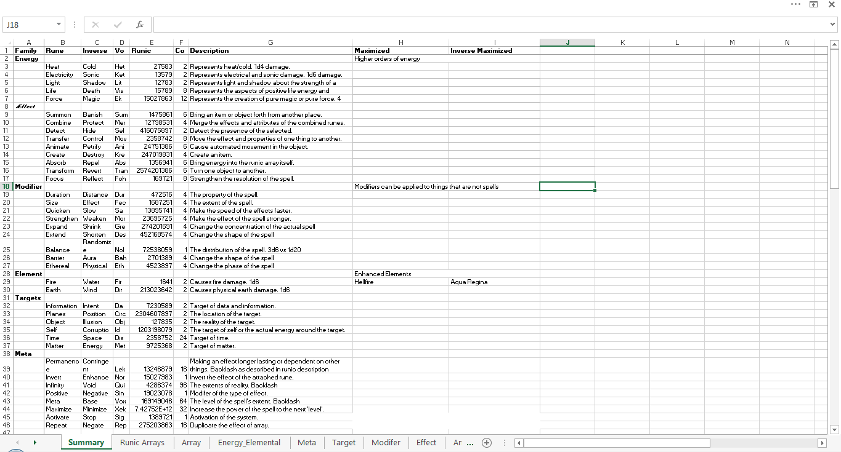
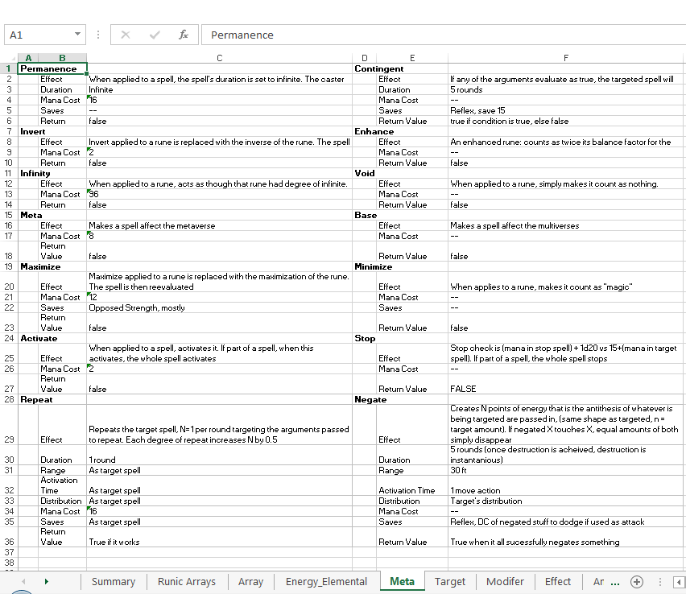
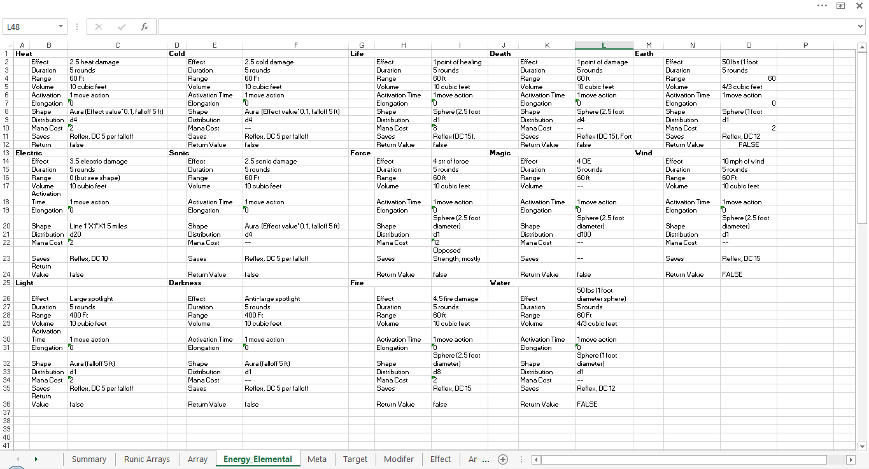
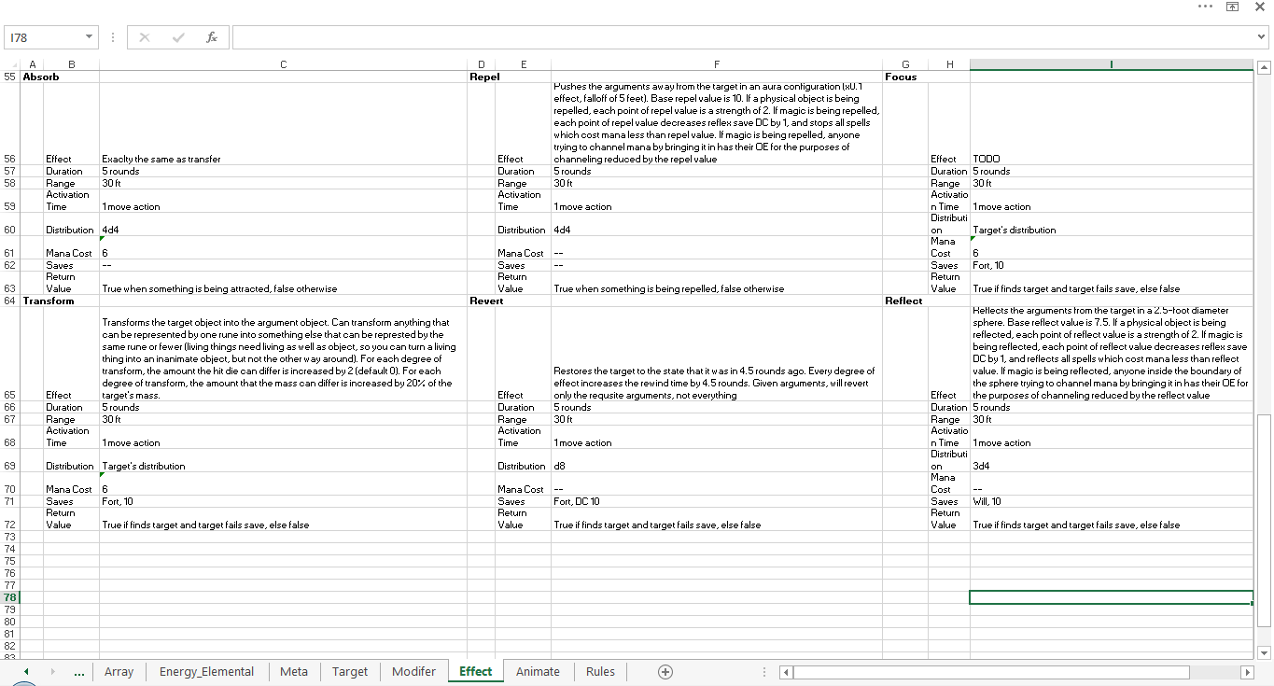
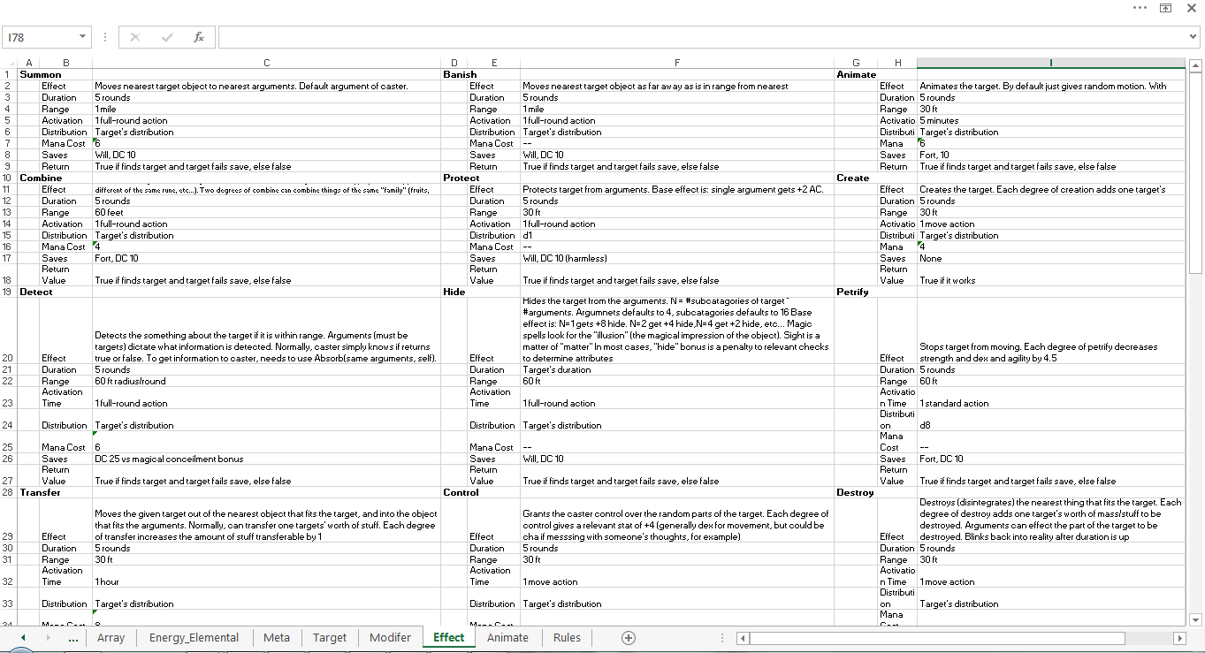
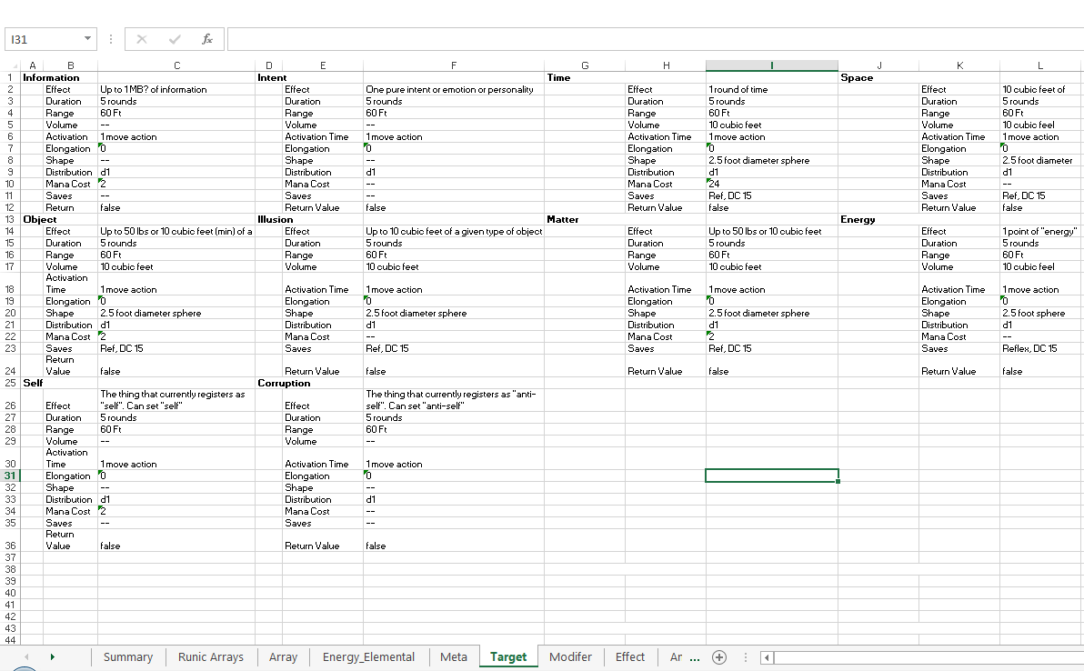
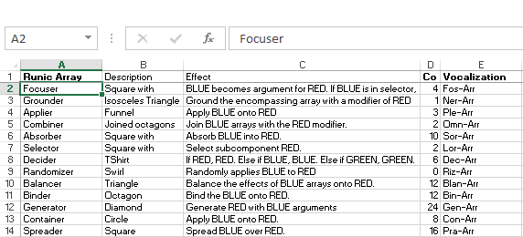
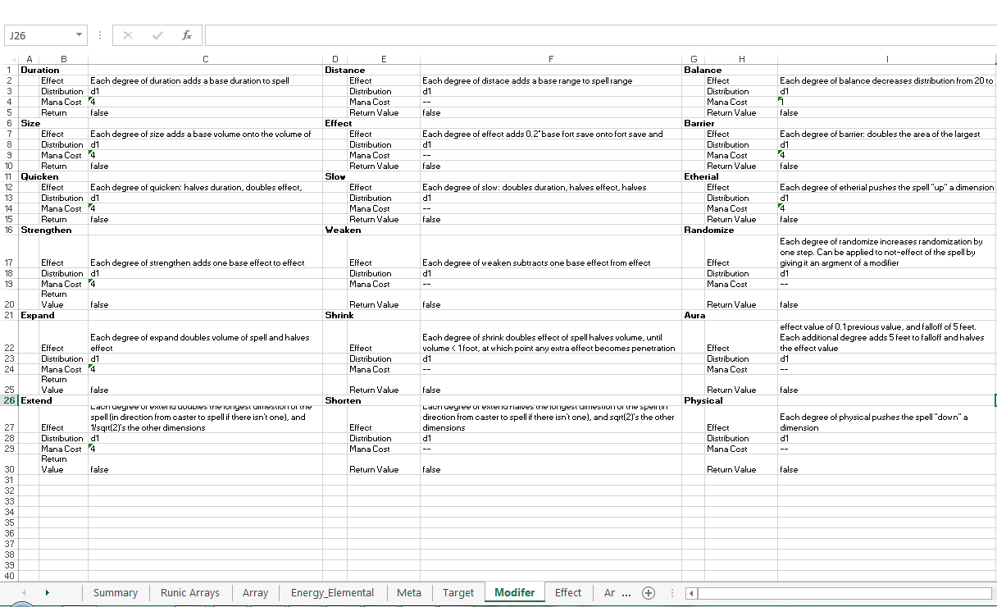

Slide 12
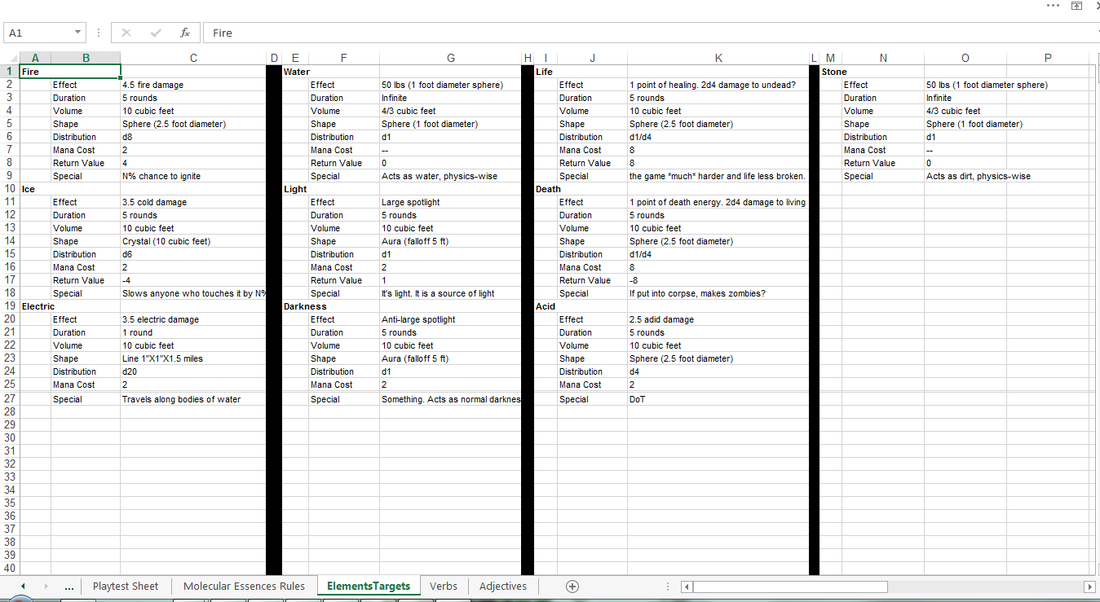
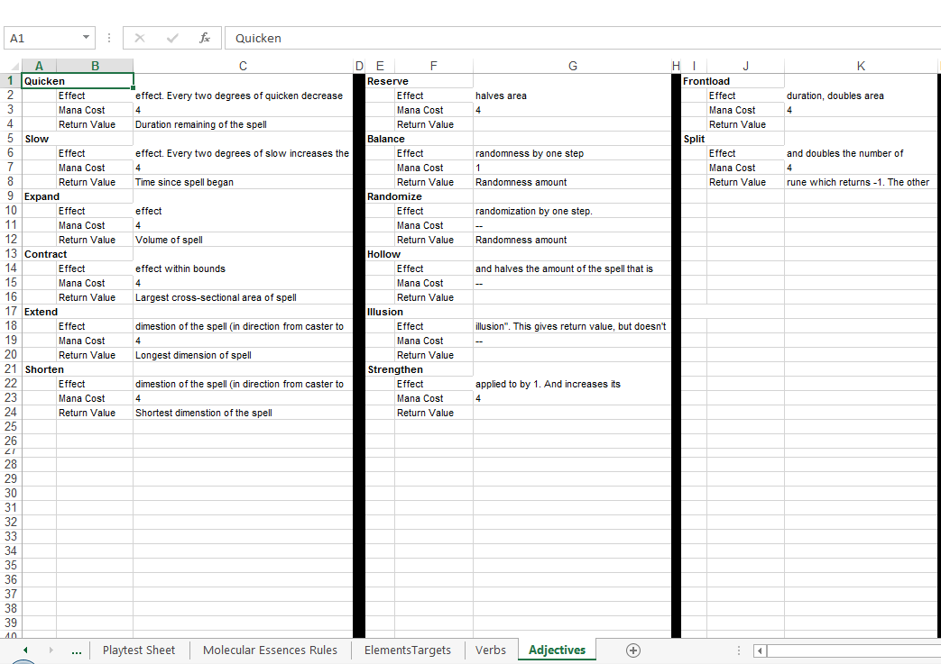
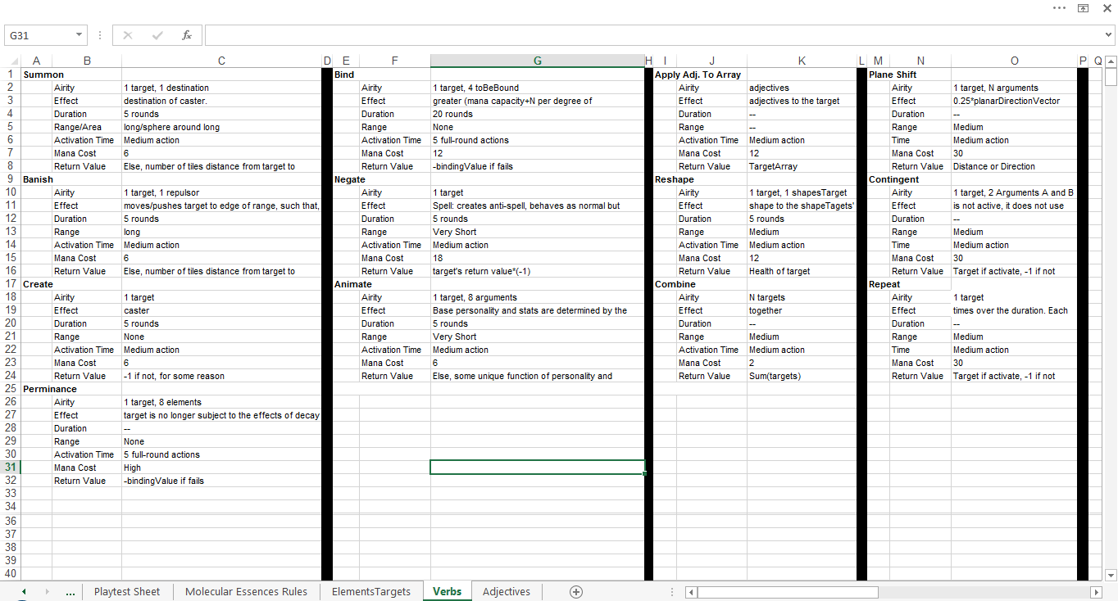
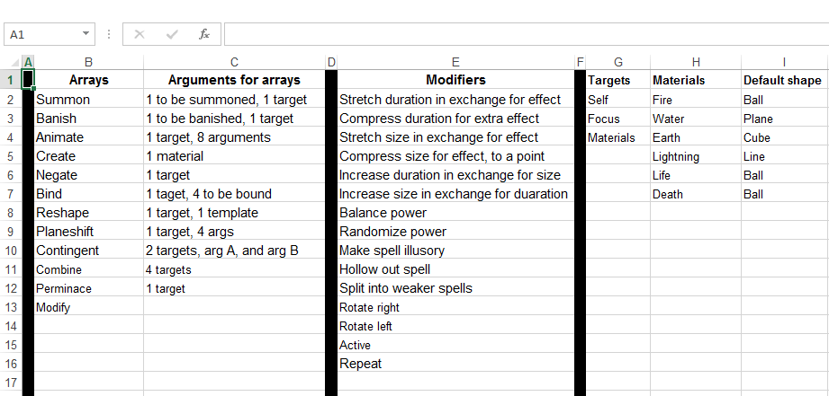

Slide 13
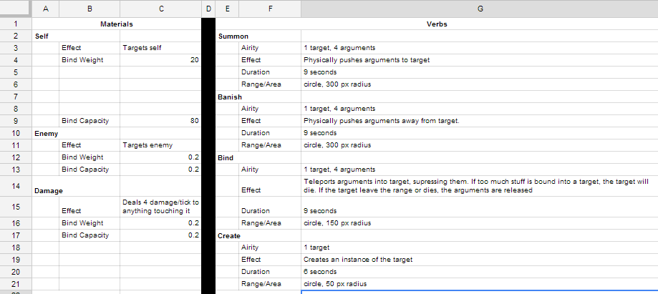

Slide 14
Depression: Are we even going to have a game?
Realizing too late how big of a hole you’ve dug yourself
Dealing with crunch
Batches of time in non-interesting tasks
Morale falters

Slide 15
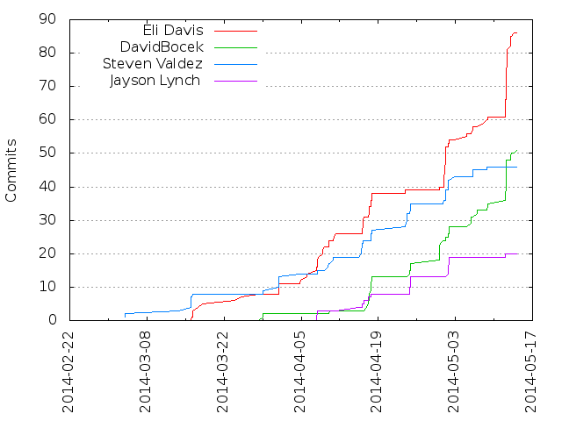
C-C-C-COMBO BREAKER

Slide 16
Lessons Learned
Refocus based on HLDD if needed
Remind yourself why you were excited about the project in the first place
Crunching in groups avoids miscommunication delays
And you keep each other on track

Slide 17
Acceptance: Proof of Concept
Cut down to the core design, make that work
A working game now is better than a perfect game tomorrow
It may not be ideal, but functional kludge is better than unfinished elegance
Be excited about what the game actually offers, even if it wasn’t what was originally intended!
I still submit that I learned more from Frog Fractions than Number Munchers.

Slide 18
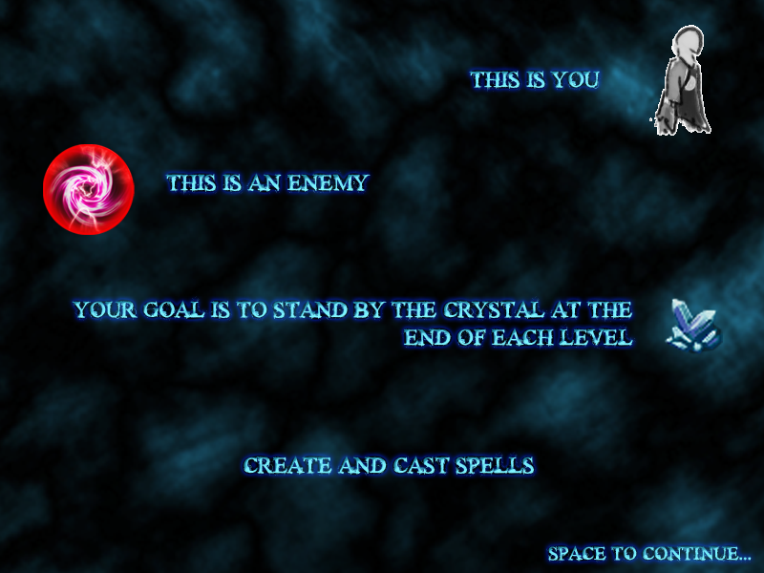

Slide 19
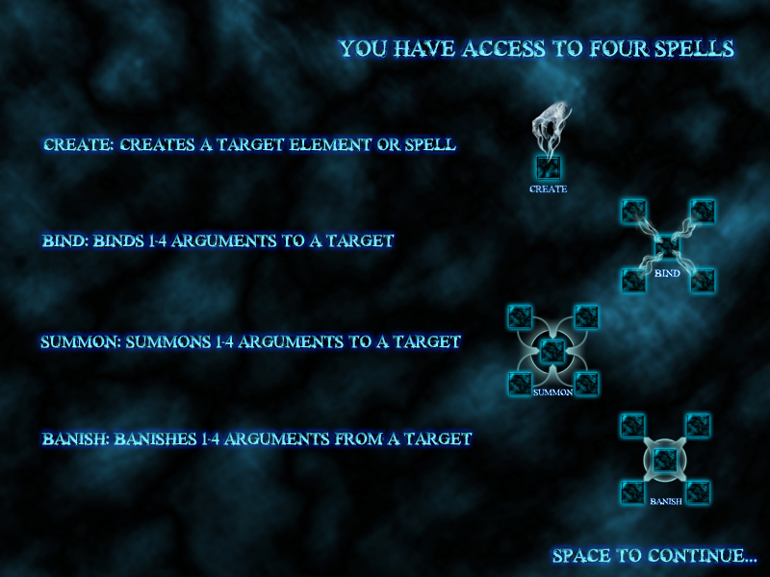

Slide 20
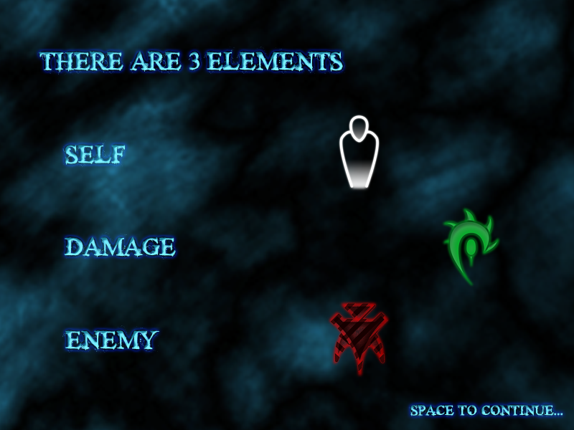

Slide 21
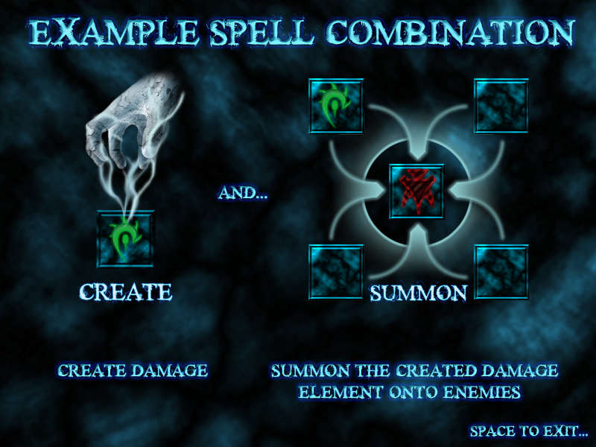

Slide 22
Lessons Learned
“Serenity to accept the things I cannot change, The courage to change the things I can, And the wisdom to know the difference”
Cutting down to a decent skeleton that holds true to the initial vision
The initial vision may be out of scope, but you can at least have a proof of concept!

Slide 23
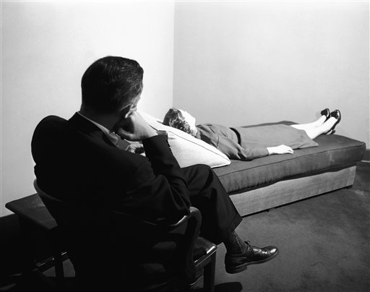
This is the last slide
Cause I couldn’t think of how to end it.
Shiet.

